Slide 1
VITA Volunteer And Site Coordinator
Application Screen Shots

Slide 2
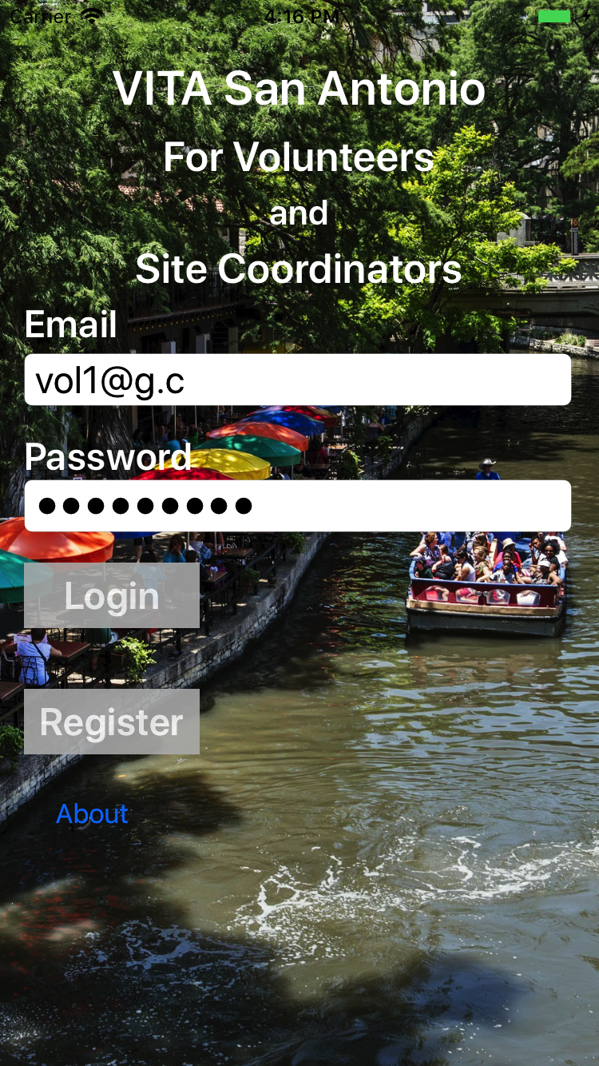
iOS/Apple devices

Slide 3
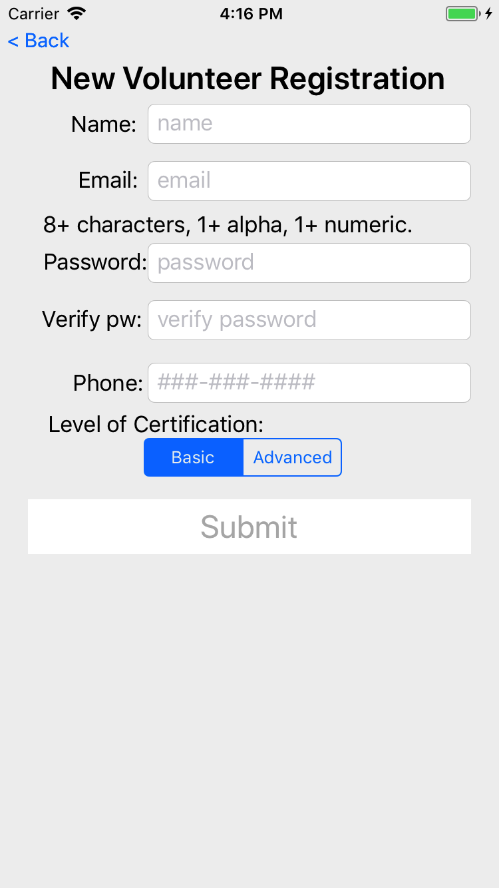
New volunteer registration
Once back office staff approves the user, they can login to the app.

Slide 4
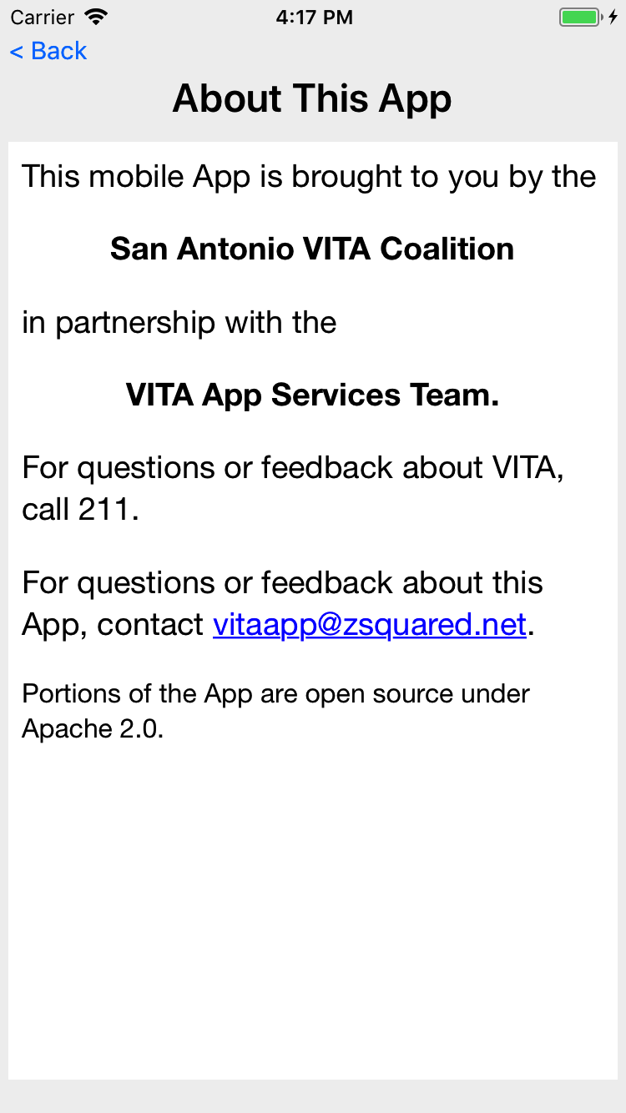
Information about the app.

Slide 5
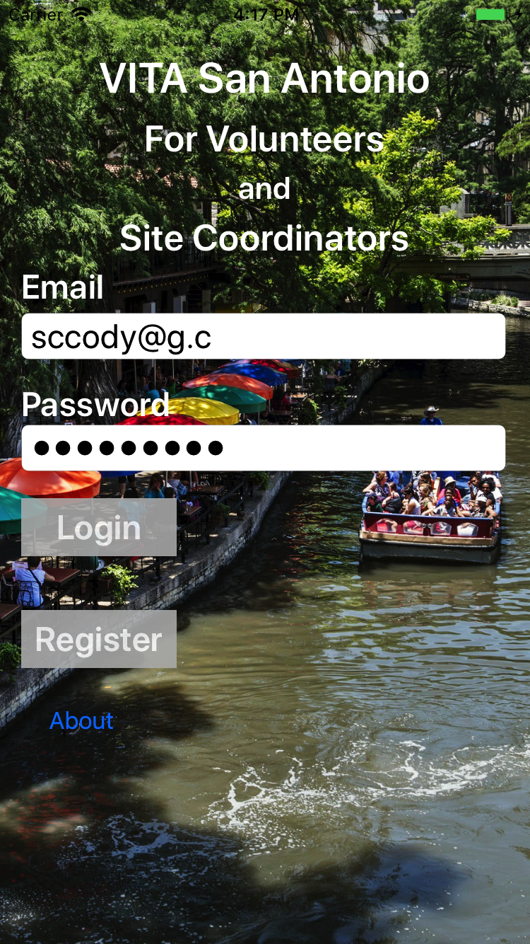
Site Coordinator login

Slide 6
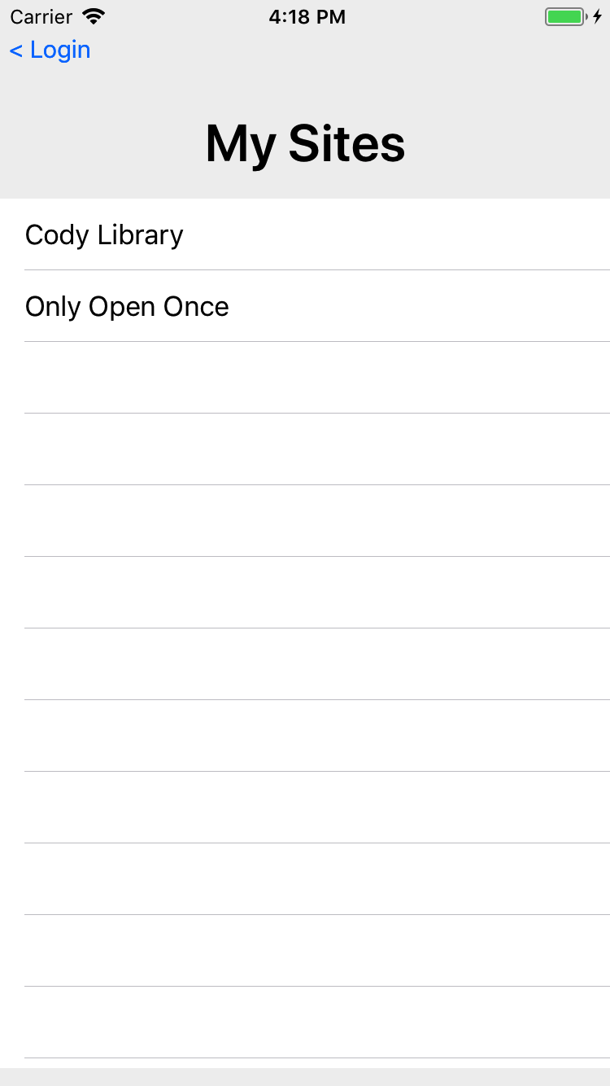
If a Site Coordinator is a primary or backup on more than one site, this screen is shown to determine which site they wish to manage.

Slide 7
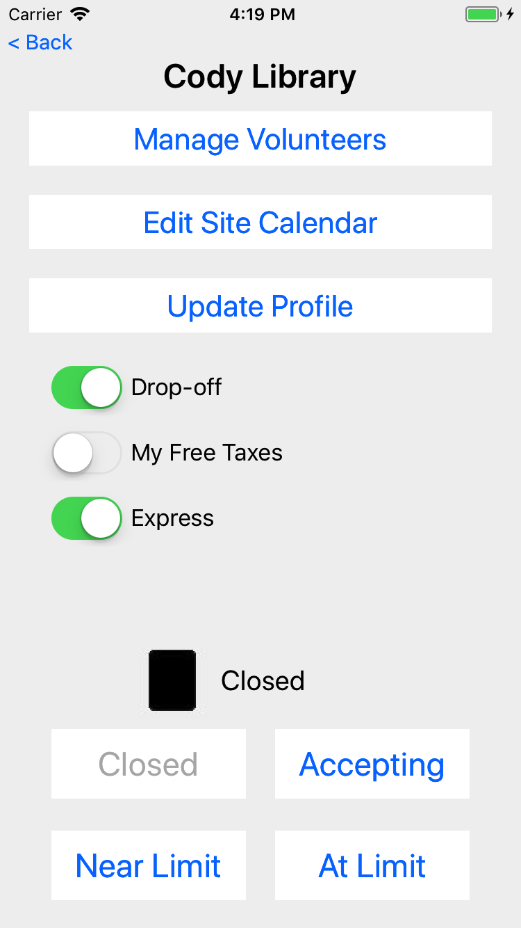
Managing the details for a Site

Slide 8
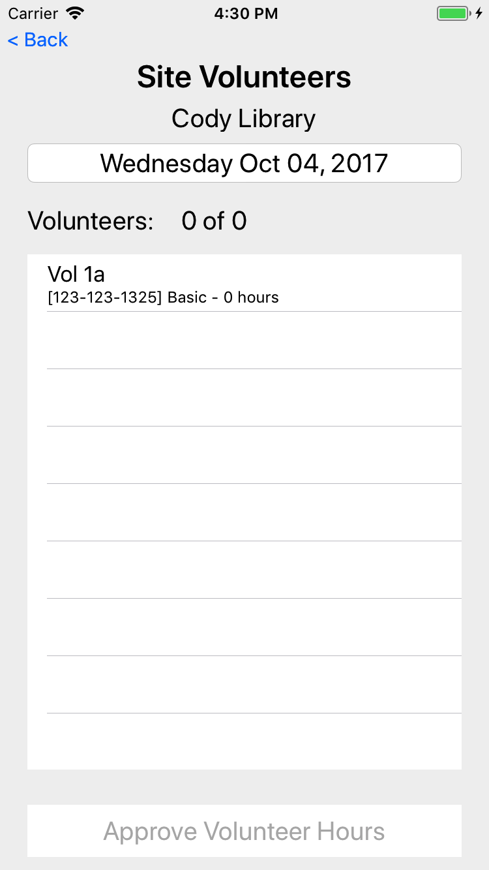
Manage Site Volunteers
Select the date
See the volunteers for that date
See phone, cert level, and hours
SC can then approve hours for today and past dates

Slide 9
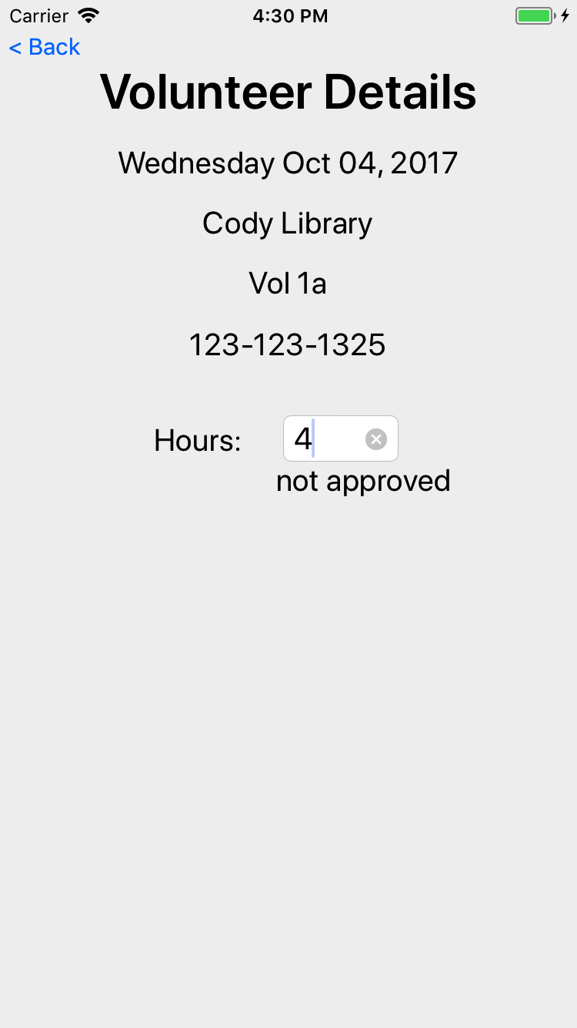
When a user is touched, the SC can adjust the hours (whether approved or not)

Slide 10
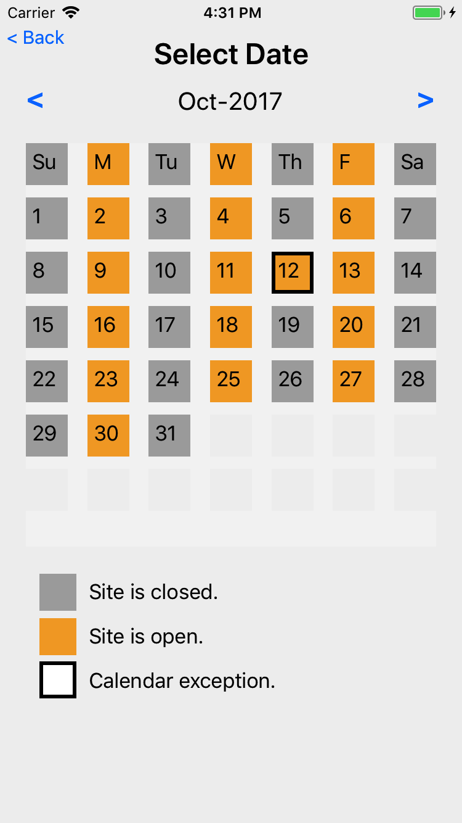
Edit Site Calendar
Touching on top row manages the defaults schedule for each day of the week
Touching a day of week allows edit/change/remove a calendar exception
The open/close for a Site is determined by starting with the defaults, then looking for an exception; if exception found, use the exception

Slide 11
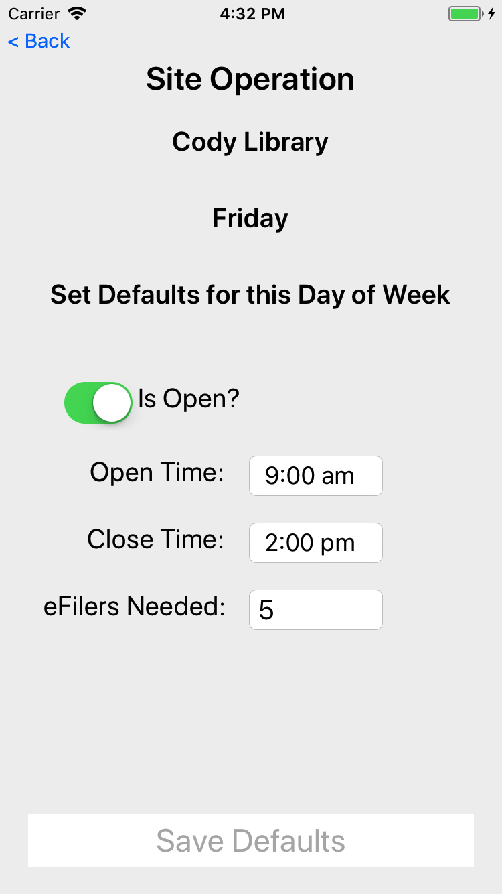
Edit site calendar defaults for each day of the week, Friday as shown here

Slide 12
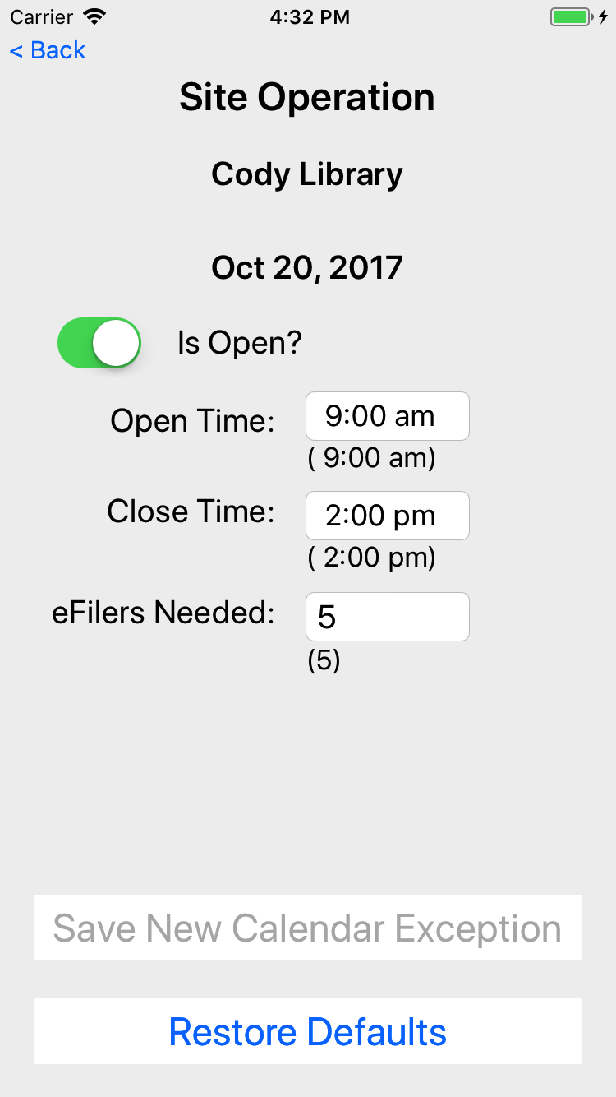
Screen to edit/remove an exception for a given date

Slide 13

Volunteer login

Slide 14
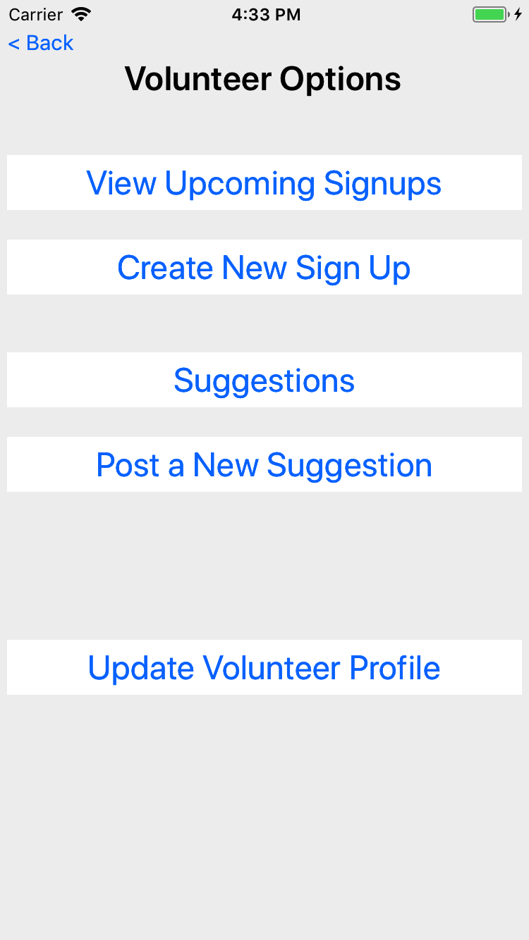
Volunteer options

Slide 15
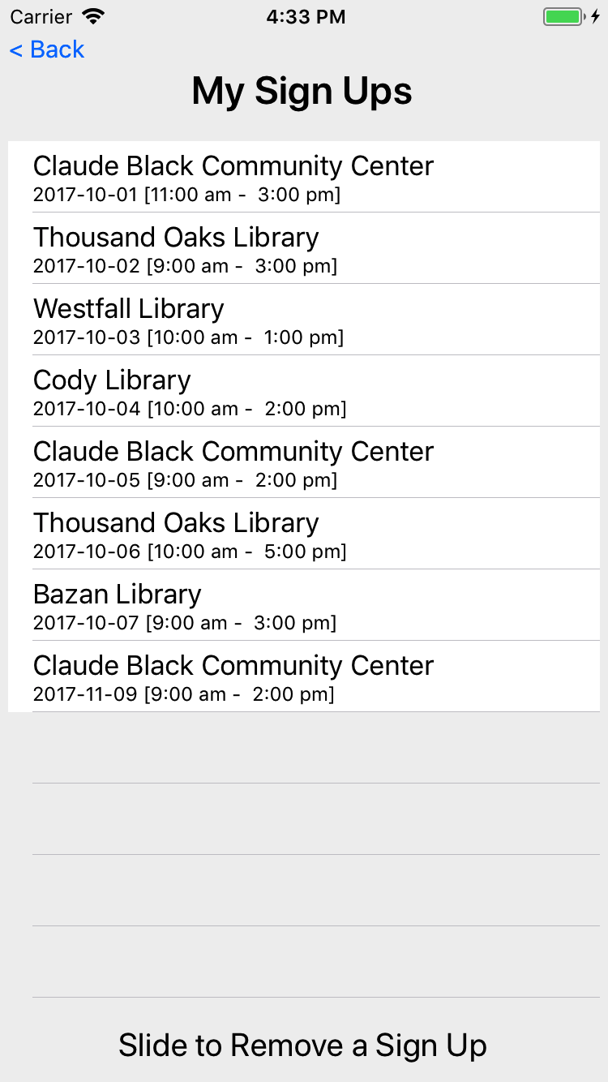
The list of signups for the volunteer, for today and moving forward.
Historical signups are not visible to the volunteer (only the site coordinator)

Slide 16
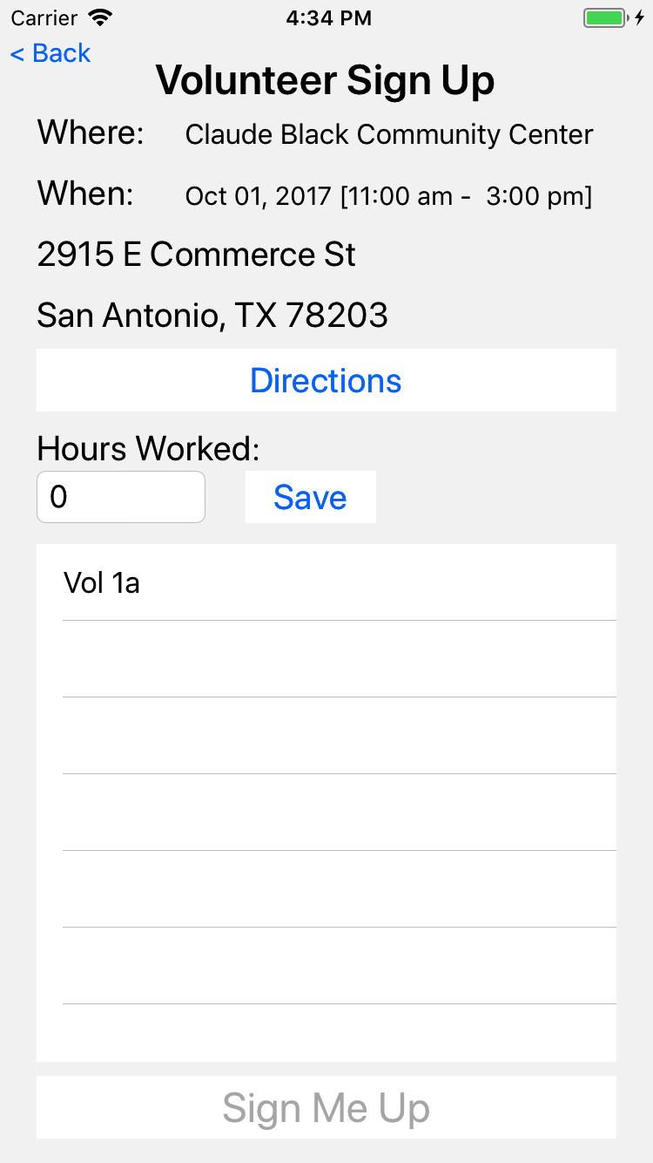
A volunteer can look a their signup, get directions to the site and adjust the hours work.
Hours work can be adjusted by the volunteer until approved by the SC.
The table at the bottom shows other volunteers at the same site on that date.

Slide 17
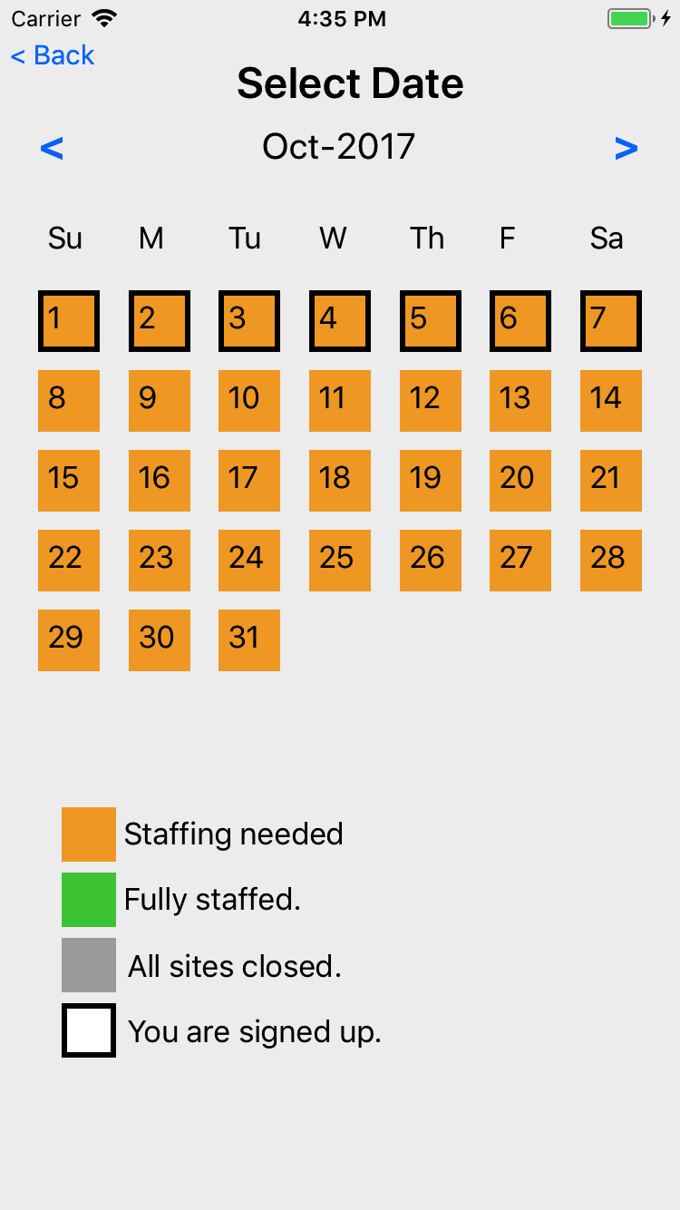
To create a new signup, a volunteer first picks a date.

Slide 18
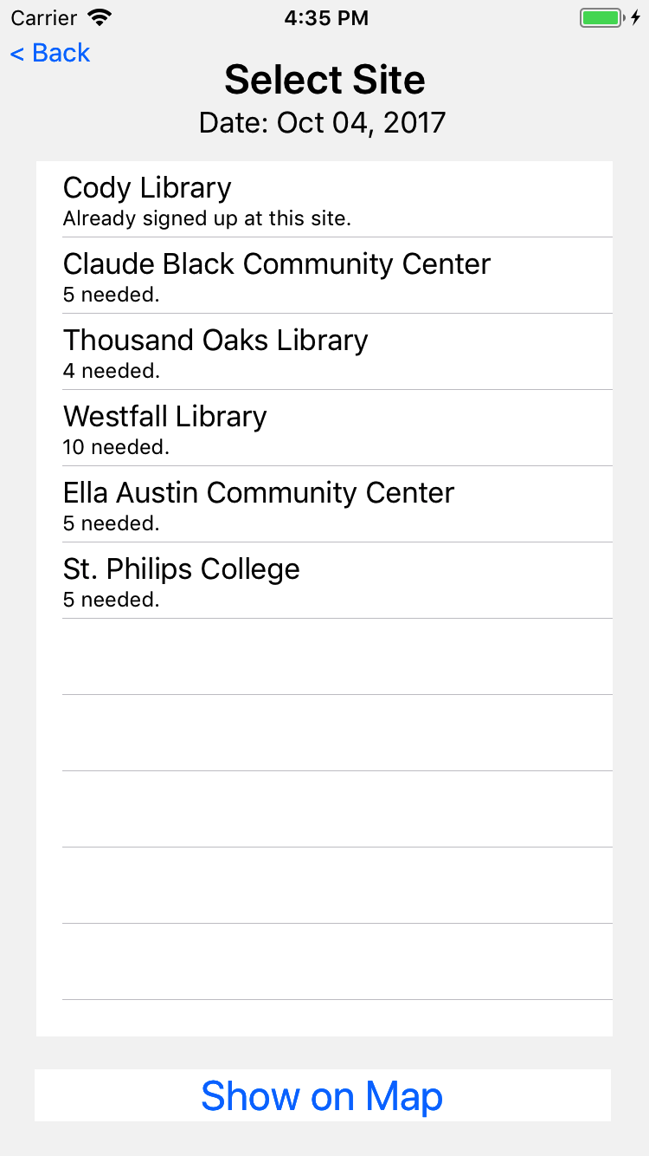
The app then shows sites open on that date that need 1 or more eFilers
If the user happens to be already signed up on that date, that site signup is show.
Mobile team members will be signed up on multiple sites per day.

Slide 19
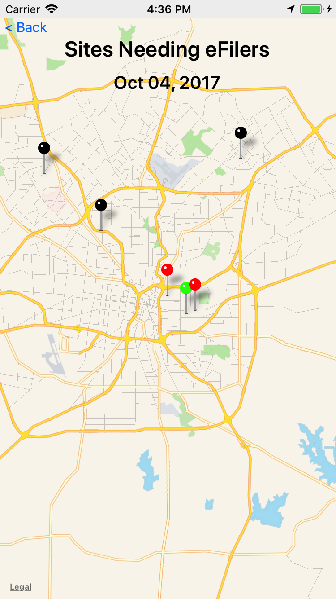
A map of sites needing eFilers
Black is a closed site
Green is a site that has all seats filled
Red is a site that needs help

Slide 20
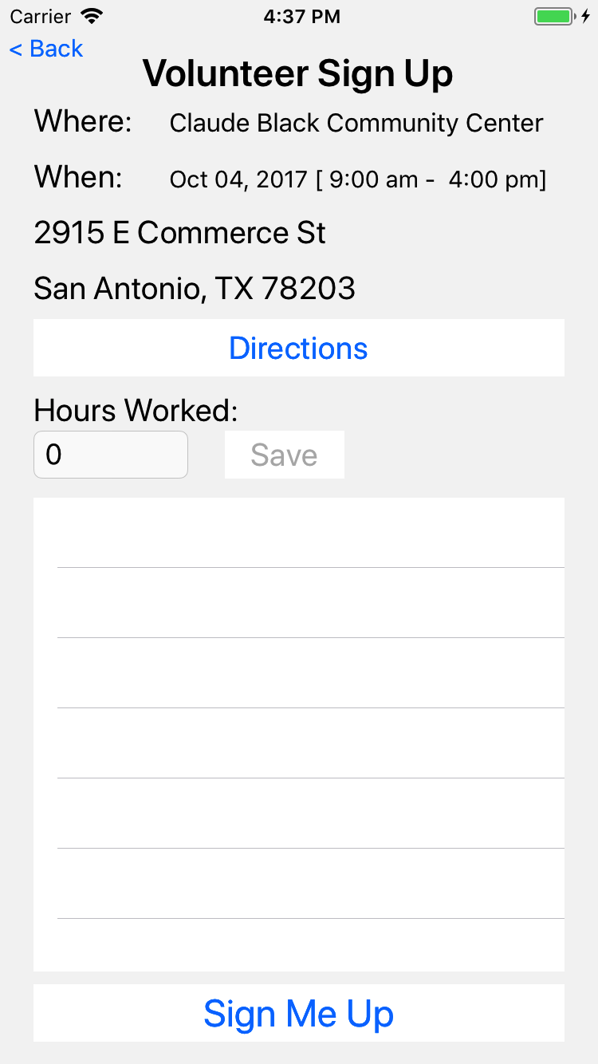
If the volunteer chooses a site, then they get a chance to sign up

Slide 21
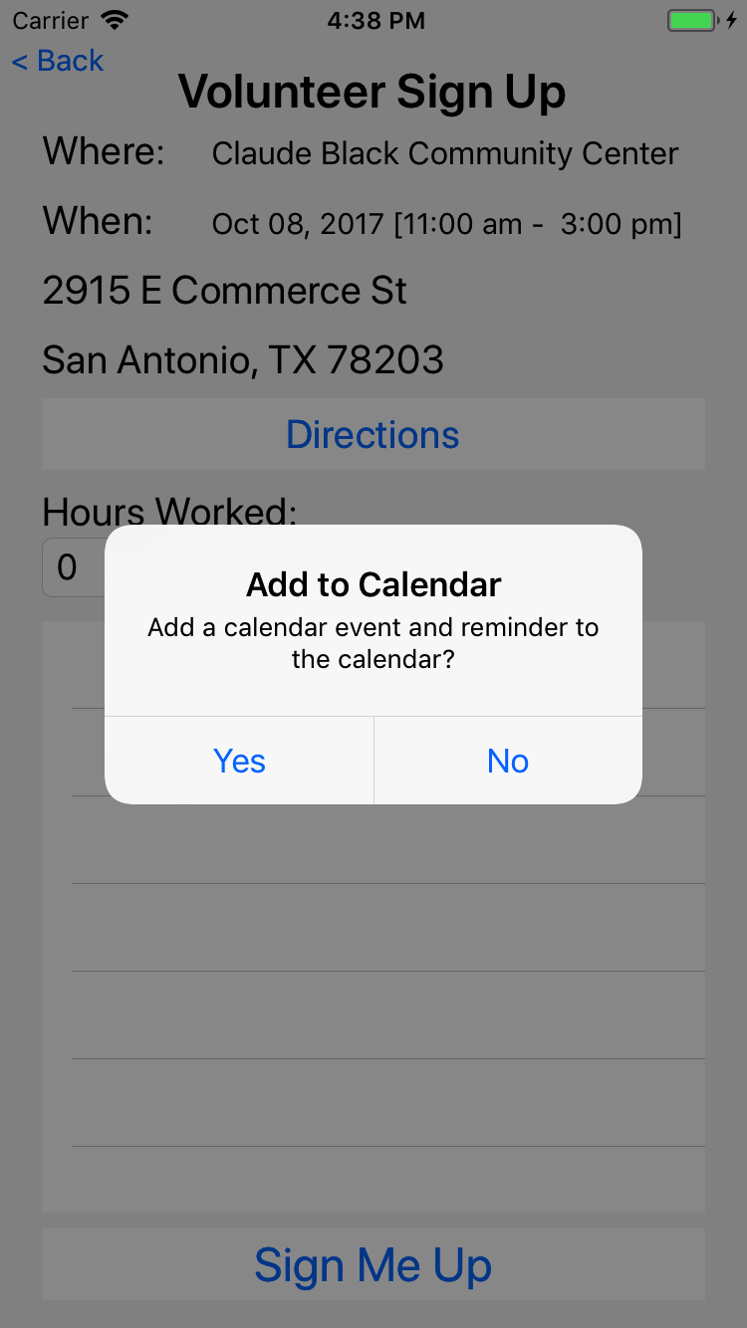
They are given an option to add to their default calendar

Slide 22
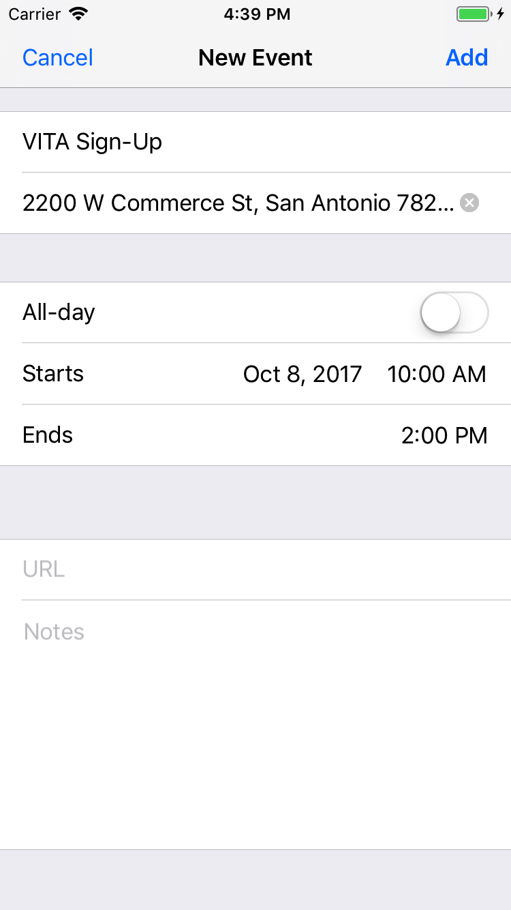
And the ability to modify the calendar event before it is saved in their calendar.

Slide 23
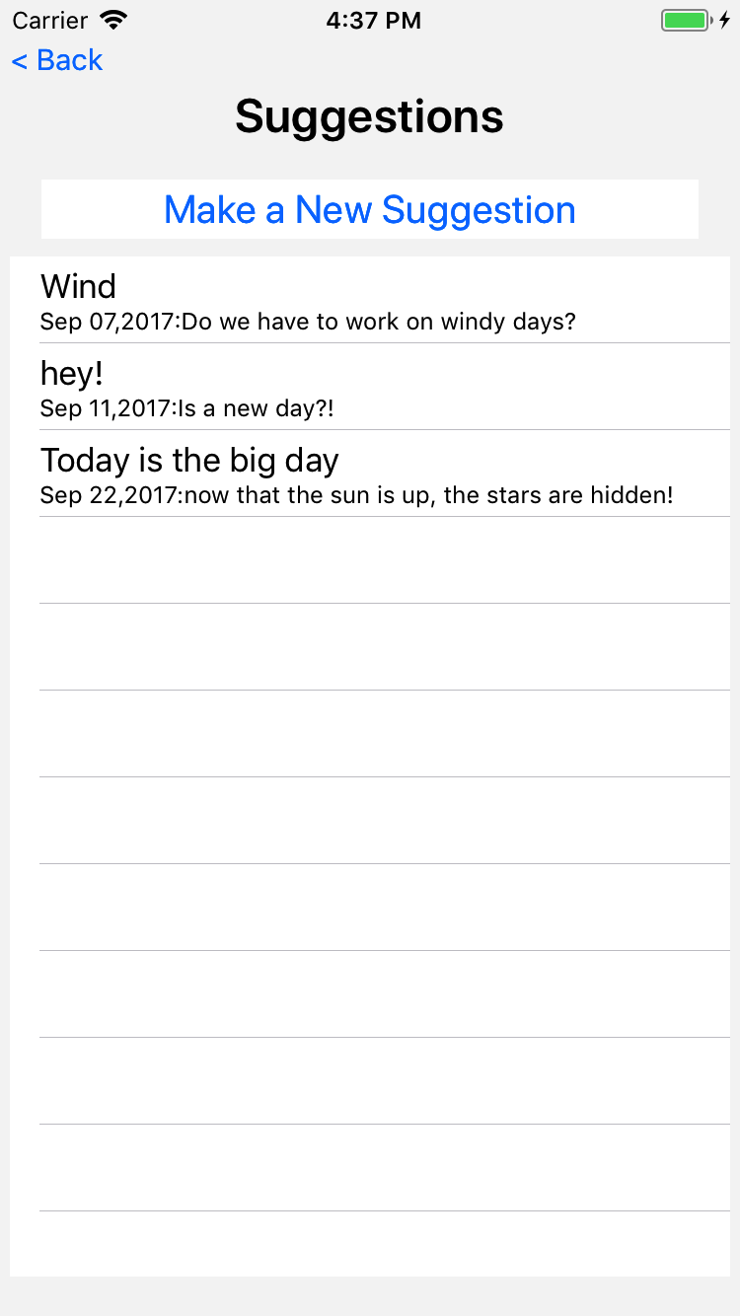
Volunteers can make suggestions.
Here is a list of suggestions from this user.

Slide 24
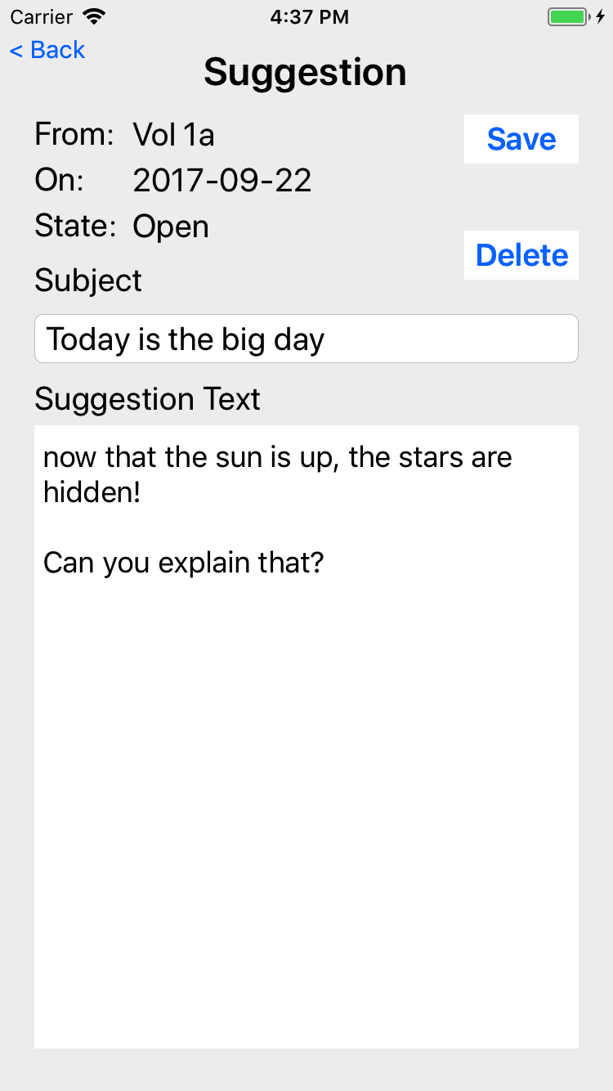
Touching a suggestion allows the user (that submitted the suggestion) to view
The user can make changes until the suggestion is read by the committee; after that, the user can only view the suggestion

Slide 25
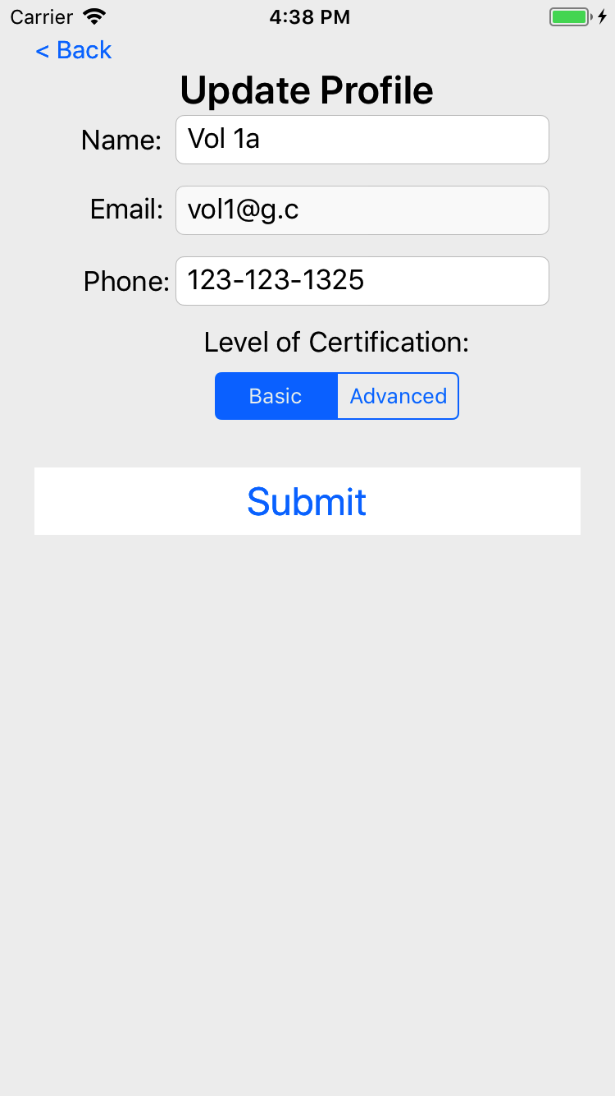
The volunteer can edit their name, phone, and certification but not their email

